Slide 1
Texas & Georgia Agriculture
Assessing the Drivers of Cotton Quality and Yield for Improved Crop Forecasting in the Southern United States
Lorryn Andrade, Nick Grener, Kelechi Igwe, Henry Osei (Analytical Mechanics Associates)
Maryland – Goddard | Spring 2025
Notes:
Speaker Notes:
Hello and thank you all for joining us today. We are the Spring 2025 Texas and Georgia Agriculture team. We worked as a virtual team during this ten week project, but our DEVELOP node was located at the Goddard Space Flight Center in Greenbelt, MD.

Slide 2




Meet the Team
Lorryn Andrade
(Project Lead)
Nick Grener
Kelechi Igwe
Henry Osei
Texas & Georgia Agriculture
Notes:
Speaker Notes:
Before we go further, we will briefly introduce ourselves!
Nick Grener
Kelechi Igwe
Henry Osei
Lorryn Andrade

Slide 3
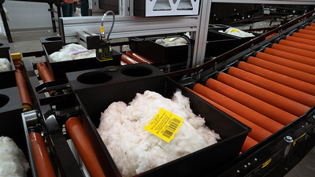
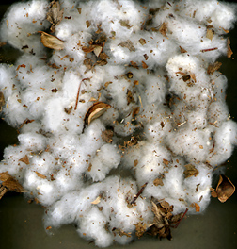
Community Concerns
U.S. represents 35% of global cotton exports
Decline in cotton yields and quality, leading to economic issues for national farmers and manufacturers of cotton products
Image Credit : Rene Carranza
U.S. cotton industry face challenges, including low prices, high production costs, and weak demand
Image Credit : Matthew Pelletier (USDA-Agricultural Research Service)
Texas & Georgia Agriculture
Notes:
Speaker notes:
The United States (U.S.) plays a key role in the global textile industry as the third-largest producer of cotton fiber, providing approximately 35% of global cotton exports in recent years.
Clothing is the most prominent use of cotton, but it is a versatile commodity found in many home textiles and medical supplies as well.
The U.S. cotton industry faced several significant challenges in 2024, including low prices, high production costs, and weak demand.
These factors combined to make 2024 another difficult year for cotton growers. The cost of fiber substitutes (particularly polyester and other synthetics) also impacts the price of cotton. If cotton prices rise too high, manufacturers can substitute synthetics in place of cotton. Given the number and variety of alternatives, cotton producers face stiff price competition and continually operate in a competitive environment, so maintaining consistent harvests of high quality is vital.
------- Image Credits -------
Image Credit: Rene Carranza
Image Title: Cotton Grading Complex in Lubbock, Texas on 14 September 2022.
Image Source: https://www.flickr.com/photos/usdagov/52453338234/in/photostream/
licensed under CC by Public Domain Mark 1.0
------- Image Credits -------
Image Credit: Matthew Pelletier
Image Title: Color image showing high levels of trash in a sample of cotton before ginning.
Image Source: https://www.ars.usda.gov/oc/images/photos/nov08/d1269-1/
Photo courtesy of USDA Agricultural Research Service

Slide 4

Partners
The Agricultural Research Service (ARS) develops applications and technologies for cotton growth and processing.
The Agricultural Marketing Service (AMS) creates marketing opportunities for cotton fiber products.
Cotton Incorporated helps companies develop and market superior cotton products.
Image Credit : United States Department of Agriculture
Texas & Georgia Agriculture
Notes:
Speaker Notes:
Our partners in this study are invested in the continued success of the US cotton industry and are interested in understanding the environmental drivers of cotton quality and yield across high producing regions in the U.S. We worked with two agencies within the U.S. Department of Agriculture:
The Agricultural Research Service (ARS)- specifically the Cotton Quality and Innovation (CQI) Research Unit- develops new processes, applications and product-enabling technologies which facilitate the expanded use and enhanced value of U.S. cotton.
The Agricultural Marketing Service (AMS) administers programs that create domestic and international marketing opportunities for U.S. producers of food, fiber, and specialty crops. AMS also provides the agriculture industry with valuable services to ensure the quality and availability of wholesome food for consumers across the country.
A third partner in our project was Cotton Incorporated, a not-for-profit company that provides the resources and research needed to help companies develop and market superior, innovative, and profitable cotton products.
Throughout the course of our project, in addition to providing us with some of the data needed to complete our analysis, these partners also offered insight into some important details of how cotton is grown and processed in the South.
Currently USDA doesn’t have any process to identify predictors of cotton quality. That’s why USDA partnered with NASA DEVELOP to identify environmental variables affecting cotton quality, thus helping farmers in the decision-making process of growing a better quality cotton.
------- Image Credits -------
Logo used with permission of Michael Cosh, USDA Research Hydrologist
Image Link: https://www.usda.gov/about-usda/policies-and-links/digital/usda-style-guide/logo

Slide 5
Objectives
Characterize cotton phenology in each region
Identify key variables associated with cotton quality
Evaluate the relationship between environmental factors and cotton quality/yield
Texas & Georgia Agriculture
Notes:
Speaker Notes:
The NASA DEVELOP team in partnership with the USDA ARS and AMS and Cotton Incorporated aims to unravel any underlying relationships that may exist between environmental conditions and cotton quality metrics.
Our three objectives were:
1. Characterize cotton phenology in Southern Georgia and Western Texas
2. Identify key abiotic variables associated with cotton quality
3. Evaluate the relationship between environmental factors and cotton quality/yield

Slide 6
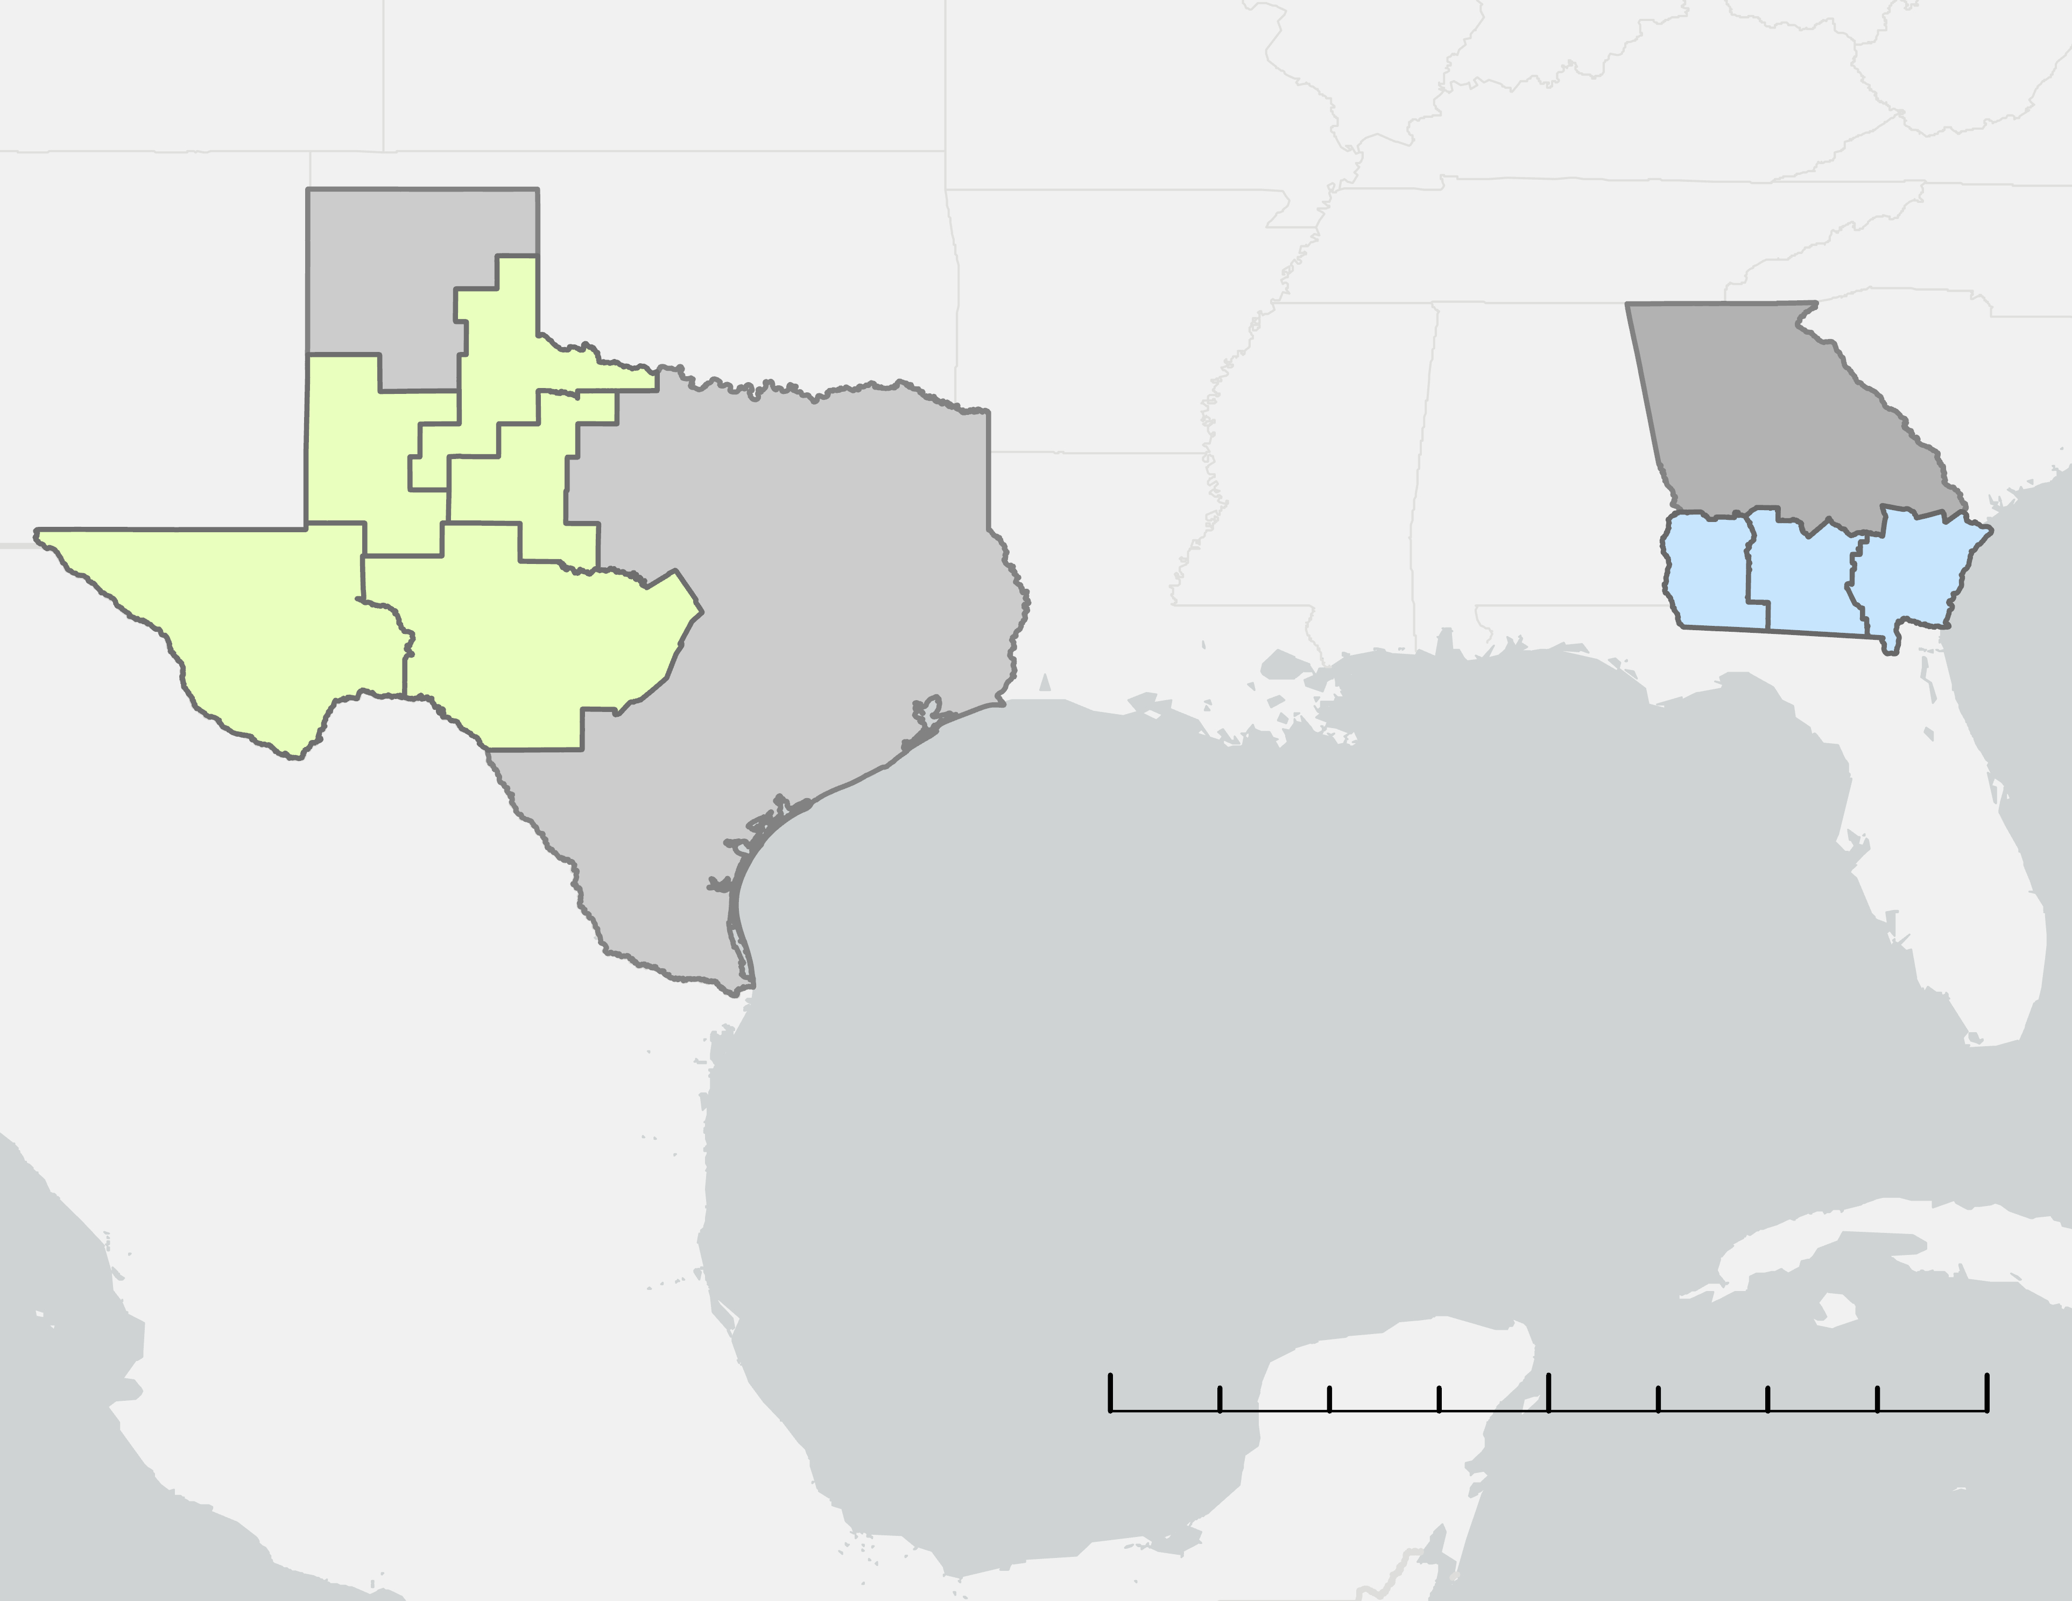


Study Area
21
GA
12
22
TX
70
80
90
60
70
Texas & Georgia
~50% of Domestic Production
Georgia Districts of Interest
Texas Districts of Interest
N
0
400
800
Miles
Basemap credits: Esri, TomTom, Garmin, FAO, NOAA, USGS, © OpenStreetMap contributors, and the GIS User Community
Texas & Georgia Agriculture
Notes:
Speaker Notes:
Texas and Georgia have been the two most significant states for growing cotton in recent years, together representing approximately 50 percent of domestic production, so it is crucial to ensure continued production of high quality cotton in these regions. The two states are in distinct climate zones, and they were selected for this feasibility study to evaluate how distinct climate variables affect cotton quality and yield. Additionally, each of these regions has experienced significant weather events in the past decade, in the form of tropical storms in Georgia and droughts in Texas. National Agricultural Statistics Service Districts – or NASS Districts - are groupings of counties in each state that tend to share similar geography, climate, and cropping practices. We began our study focusing on three NASS Districts in Georgia and 5 NASS Districts in Texas.
------------------------------------------Image Information Below-----------------------------------------
Map by: Georgia&TexasAg Team
Basemap credits: Esri, TomTom, Garmin, FAO, NOAA, USGS, © OpenStreetMap contributors, and the GIS User Community
(insert something about the differences between the two regions)

Slide 7

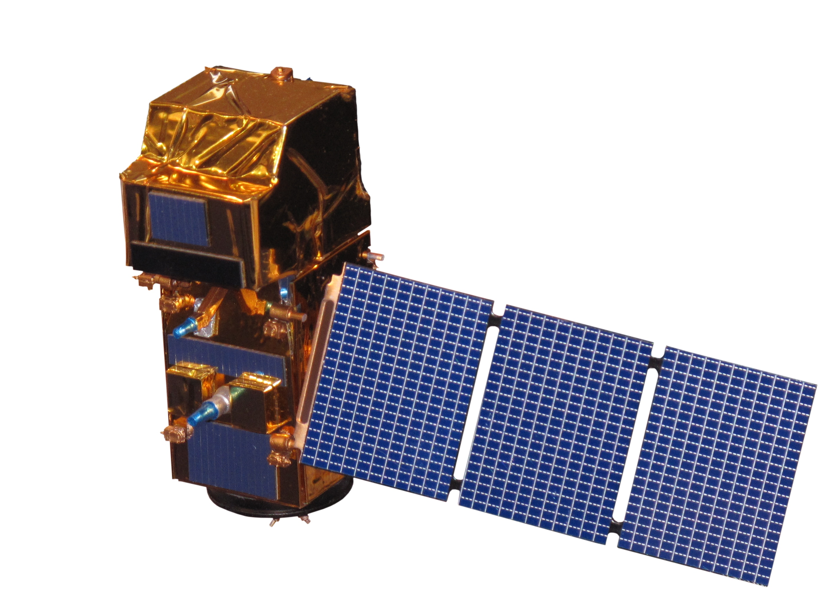
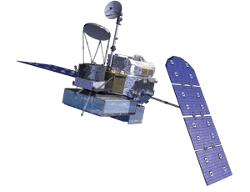
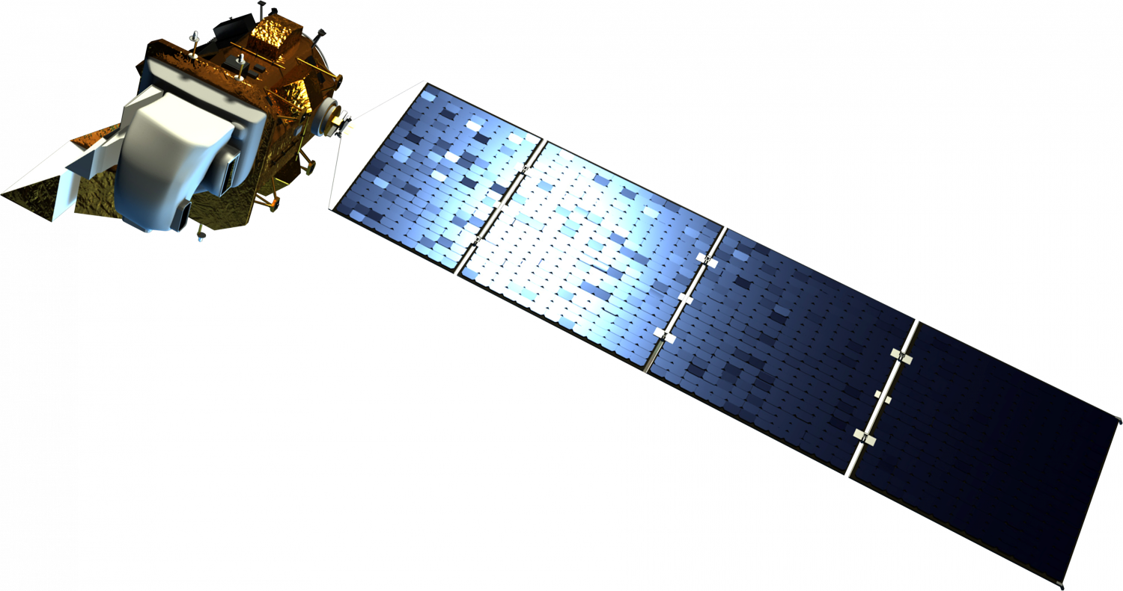
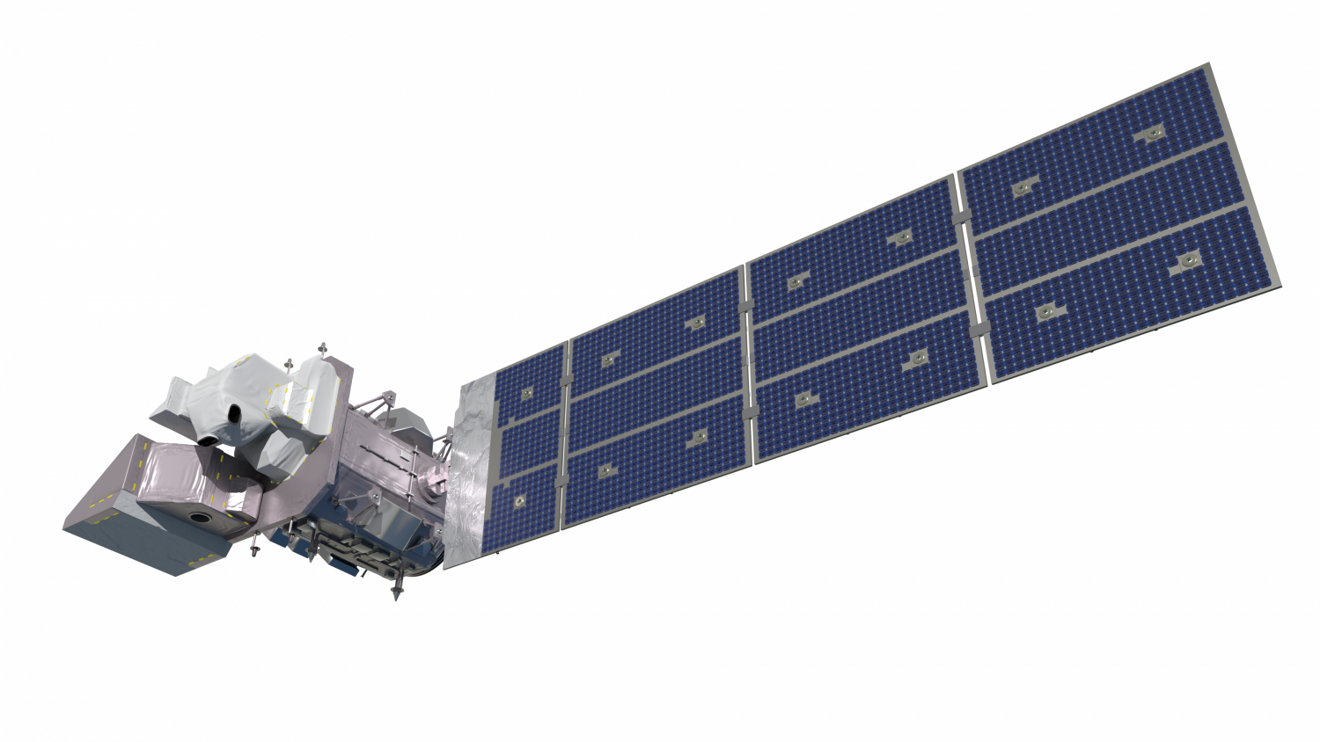
Earth Observations
Sentinel-2 MSI
SMAP
GPM
Landsat 8 OLI
Landsat 9 OLI-2
Image Credits: Rama (Sentinel-2 MSI), NASA (all others)
Texas & Georgia Agriculture
Notes:
Speaker Notes:
Remote sensing technologies provides a unique and less labor-intensive opportunity to monitor environmental processes that might be influencing cotton quality. We used data products from a variety of space-borne observations. The Harmonized Landsat Sentinel-2 OLI/MSI Project, also known as HLS, incorporates observations from the European Space Agency's Sentinel-2 MSI as well as both NASA Landsat satellites shown here. HLS provided spectral band readings that allowed us to calculate vegetative indices. Root Zone Soil Moisture was estimated from NASA's Soil Moisture Active Passive (SMAP) L-band Radiometer. GPM is the core satellite in the Global Precipitation Measurement constellation which contributes information to the IMERG precipitation estimates which are available over most of the Earth's surface, including regions where ground-based estimates are not possible.
------- Image Credits -------
Image Credit (Sentinel-2 MSI): Rama
Image Title: Model of Sentinel-2
Image Source: https://commons.wikimedia.org/wiki/File:Sentinel_2-IMG_5873-white_(crop).jpg
licensed under CC by SA 2.0 FR
Image Title: Landsat 8 OLI
Image Credit: NASA
Image Source: https://science.nasa.gov/multimedia/spacecraft-icons/
Image Title: Landsat 9 OLI-2
Image Credit: NASA
Image Source: https://science.nasa.gov/multimedia/spacecraft-icons/
Image Title: GPM
Image Credit: NASA
Image Source: https://science.nasa.gov/multimedia/spacecraft-icons/
Image Title: SMAP
Image Credit: NASA
Image Source: https://science.nasa.gov/multimedia/spacecraft-icons/

Slide 8
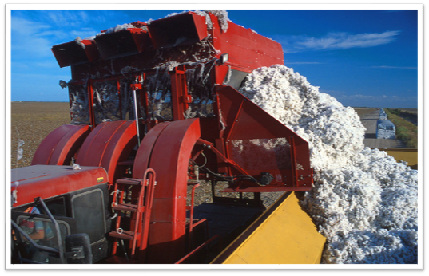


Study Period
2015 – 2024
Growing Seasons
(May to November)
HLS and SMAP satellite
data availability
Image Credit: David Nance
Texas & Georgia Agriculture
Notes:
Speaker Notes:
The timeframe of the study was chosen based on the availability of the Harmonized Landsat Sentinel-2 (HLS) and Soil Moisture Active Passive (SMAP) data. Also, we took into consideration that the growing season for cotton is between May to November.
------- Image Credits -------
Image Credit: David Nance
Image Title: Cotton is harvested in Texas
Image Source: https://www.flickr.com/photos/usdagov/8497804030
licensed under CC by 2.0 Deed

Slide 9
Environmental Factors of Interest
Temperature
Growing Degree Days (GDD)
Wind Speed
Maximum Wind Speed
Precipitation
Precipitation
Estimated with remote sensing products
Soil Moisture
Root Zone Soil Moisture (RZSM)
Biomass
Enhanced Vegetation Index (EVI)
Texas & Georgia Agriculture
Notes:
Speaker Notes:
On the left we can see the main environmental factors that affect cotton quality. On the right, we see the derived measurements that we used for this study. Some of these values, such as growing degree days, are weather data that are commonly used to make predictions about cotton harvesting dates, and in some cases have been shown to affect certain aspects of cotton quality in the laboratory setting. Growing degree days gives a rough measure of how many heat units crops are exposed to by accumulating how many degrees the average temperature is each day above some critical threshold for growth, which in the case of cotton is accepted to be 60 degrees Fahrenheit.
In terms of the remotely sensed measurements, we did not have to calculate the root zone soil moisture estimates ourselves, as there is a NASA product provided at a resolution of 9 km that incorporates the aforementioned SMAP satellite observations into physically-based models of the land surface water, energy, and carbon cycles. In contrast to this, we had to calculate the Enhanced Vegetation Index ourselves. EVI is a measure of plant health and greenness, often used to monitor crop development over time. It ranges from -1 to 1, with values between 0 and 1 indicating vegetation and those closer to 1 representing healthier, greener plants. Our goal was to integrate these remotely sensed observations into our model to see if the accuracy of cotton quality predictions could be improved with this information.

Slide 10
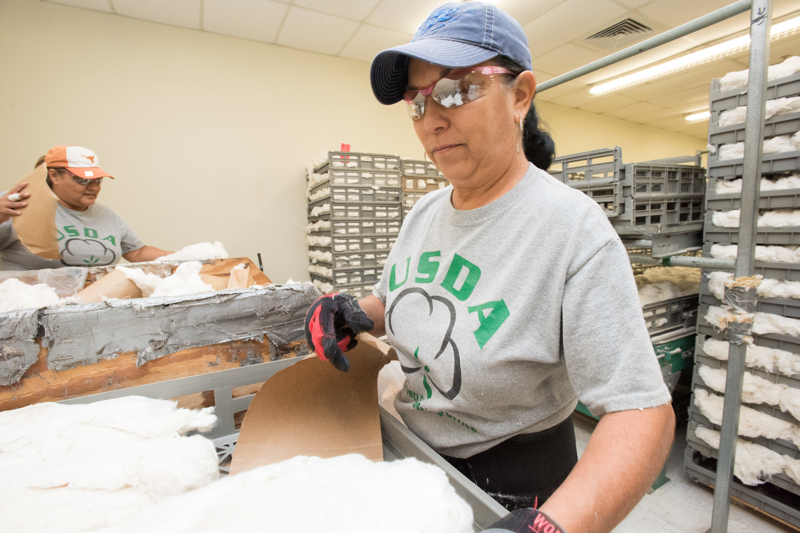
Cotton Quality Indicators
Micronaire
Fiber length
Fiber strength
Length uniformity
Surface area trash
Color
(reflectance & yellowness)
Image Credit: Lance Cheung
Texas & Georgia Agriculture
Notes:
Speaker Notes:
Cotton quality was defined in our study based on the commonly-used metrics shown here. These metrics are utilized by cotton classification facilities around the world for the purpose of providing quality measurement data based on internationally recognized and accepted levels. Each 480 pound cotton bale that is ginned has a representative one-half pound sample removed from it which is run through a High Volume Instrument (HVI) system. The resulting measurements on the variables listed here – as well as a few others that we did not investigate - are attached to the whole bale. These measurements were provided to us by the USDA AMS for nearly all of the bales ginned in our study area.
For example, micronaire is a measurement of the cell wall thickness in the cotton fibers and indicates how permeable the fiber is; different end users desire different micronaire values in their raw product, but generally values that are neither too high nor too low are desirable. Length uniformity is important because it impacts the efficiency of the spinning process- cotton with a low uniformity index is likely to be difficult to process and produce low-quality yarn. Surface area trash is a measure of the amount of non-lint materials in cotton, such as leaf and bark from the cotton plant. This metric is determined through the use of a digital scan of the cotton sample. A high percent area of trash results in greater textile mill processing waste and lower yarn quality.
------- Image Credits -------
Image Credit: Lance Cheung
Image Title: U.S. Department of Agriculture (USDA) Agricultural Marketing Service (AMS) Cotton Program staff and facility quickly resumed work following Hurricane Harvey, the inspection and grading minimized the financial impact on this industry, in Northwest Corpus Christi Texas, on September 19, 2017.
Image Source: https://www.flickr.com/photos/usdagov/37173792132
licensed under licensed under CC by Public Domain Mark 1.0

Slide 11
Methodology
Satellite Data
Modeled Data
Ground-based Data
USDA NASS Cotton Quality
USDA NASS Cotton Yield
HLS
SMAP
GPM IMERG
GridMET
PRISM
Crop Mask
Precipitation
Maximum Wind Speed
Growing Degree Days
Generate Ground-based Maps in ArcGIS
Enhanced Vegetation Index
Root Zone Soil Moisture
Aggregate data to level of month and NASS District
Regression & Correlation Analyses
Texas & Georgia Agriculture
Notes:
Speaker Notes:
Here you can see an overview of our team's process. Because our cotton quality data was at the spatial level of National Agricultural Statistics Service Districts, a large part of our work was to aggregate the rest of our variables- which all came at different spatial resolutions- to a matching level. Similarly, since many of the environmental variables came at different resolutions (for example, maximum wind speed was measured daily, while the precipitation totals came at monthly intervals), we had to aggregate some of our data to the monthly temporal resolution. This allowed for standardized comparisons and simplified model-building across time and space. The primary tool we used to tease our the variables that were correlated with cotton quality was multiple regression models, but we also looked at the distribution of each quality variable individually as well as a correlation matrix of all of the variables to add depth to our analysis.
PRISM creates 4km grids and uses nearby station data within each grid in a regression model to estimate localized climate for each of the climate variables.
GridMet interpolates spatial attributes from PRISM and more data from re-analysis data products like the NLDAS to generate more complete climatic datasets.
----------Image Information Below----------
[Methodology Flowchart]
Image Credit: [Lorryn Andrade - Google Drawings]

Slide 12
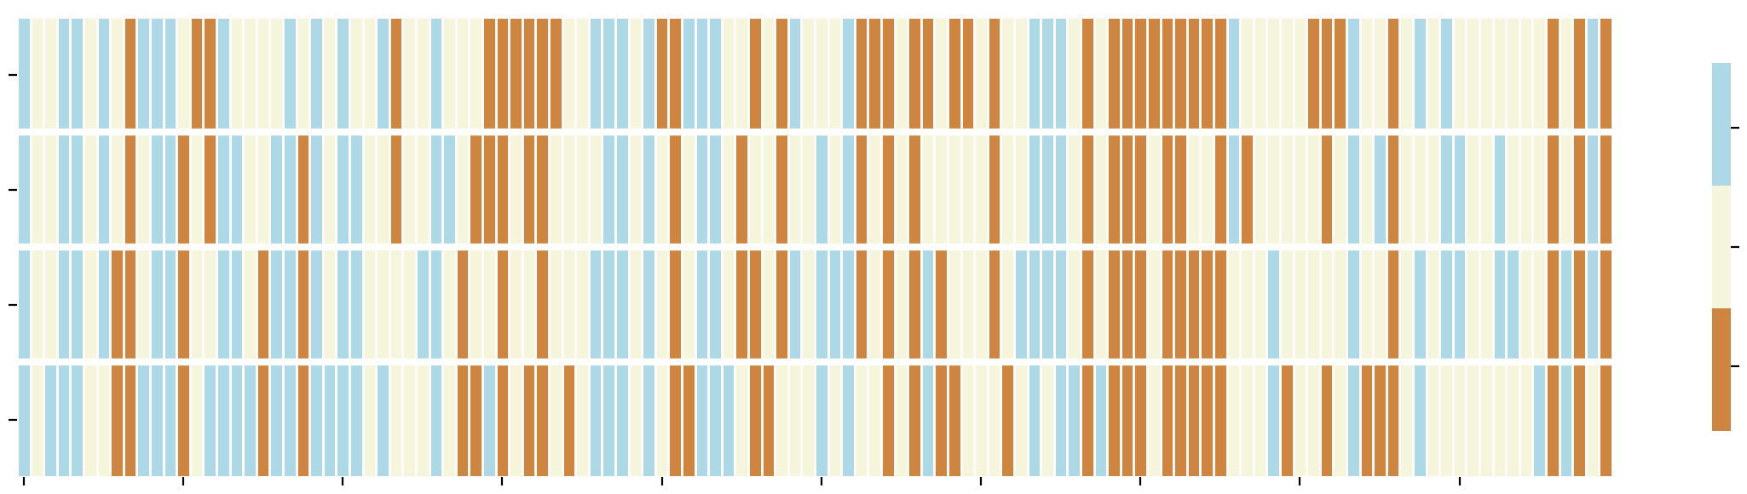
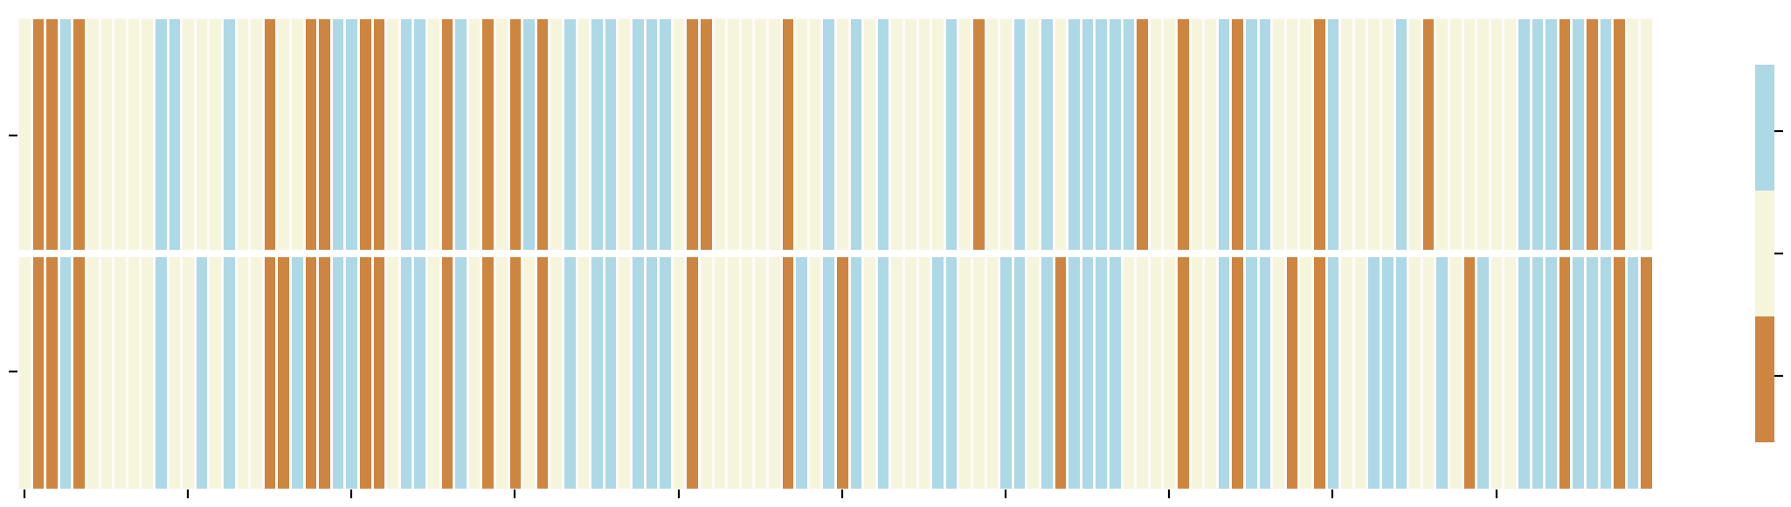
Environmental Conditions (30 Day SPI)
12
Wet
21
Texas
Normal
22
Dry
70
2015
2016
2017
2018
2019
2020
2021
2022
2023
2024
70
Wet
Georgia
Normal
80
Dry
2015
2016
2017
2018
2019
2020
2021
2022
2023
2024
Texas & Georgia Agriculture
Notes:
Speaker Notes:
Here we can see the Standard Precipitation Index through our study period for Texas and Georgia separately. This index was obtained from GridMET and indicate drought conditions by comparing monthly precipitation totals to historical averages; this data was ultimately not incorporated into our regression models because of its redundancy with the precipitation totals from the IMERG system, but it is apparent from this visualization that 2022 was an abnormally dry year in Texas, but not in Georgia. Since our NASS Districts within states bordered each other, we can observe similarities in drought conditions within states, but there is still some variability from district to district.

Slide 13
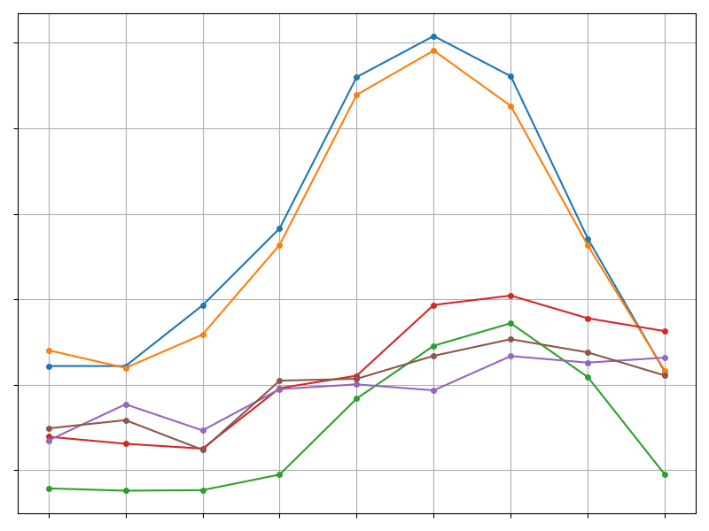
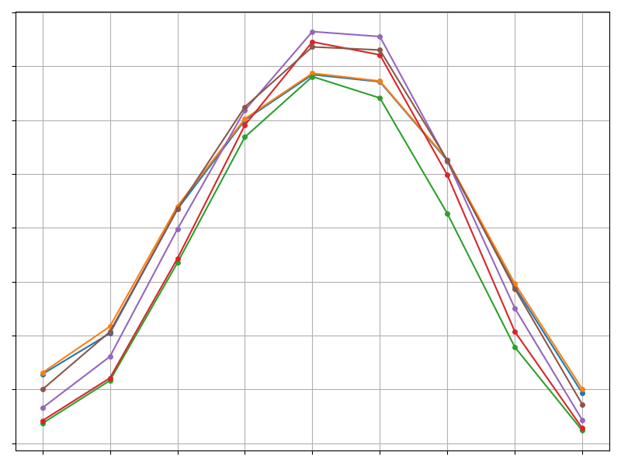
Phenology (EVI + GDD)
800
0.7
700
0.6
600
0.5
500
EVI
GDD
400
0.4
300
0.3
200
0.2
100
0
Mar
Apr
May
Jun
Jul
Aug
Sep
Oct
Nov
Mar
Apr
May
Jun
Jul
Aug
Sep
Oct
Nov
GA-70
GA-80
TX-12
TX-21
TX-22
TX-70
Texas & Georgia Agriculture
Notes:
Speaker notes:
This slide presents the monthly average EVI for cultivated cotton areas and GDD from 2015 to 2024. Cotton typically requires 60 heat units to emerge from the soil. From the GDD graph, we can infer that farmers generally start planting around March, as spring begins, and harvest around November when average GDD levels are no longer sufficient to support cotton growth. The EVI graph, which reflects vegetation presence and crop health, confirms that in all districts, the growing season often starts as early as March. Most farms are planted by June, as shown by a sharp rise in EVI. Crops reach peak health around August and September, before declining in October and November during the harvest period. Comparing peak EVI values reveals that cotton plants in Georgia are greener and healthier than those in Texas. Although both regions experience similar temperature accumulation for crop growth, this difference is likely due to Georgia's higher rainfall compared to the extreme droughts Texas has faced in recent years. These droughts have been so severe that, in 2022, Texas had to abandon as much as 84% of its planted acres.

Slide 14
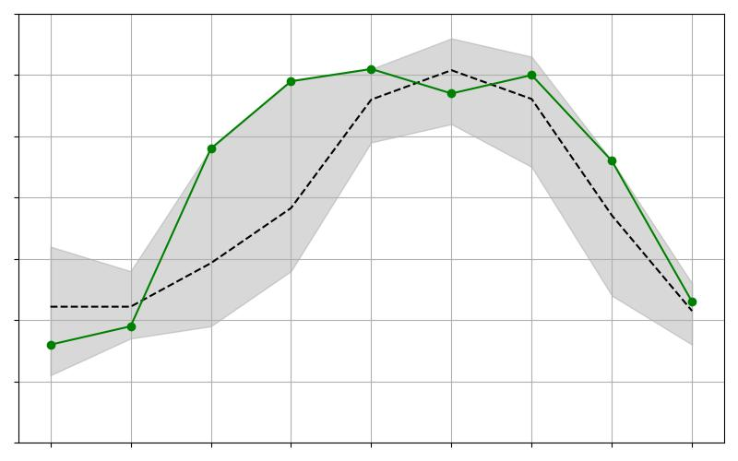
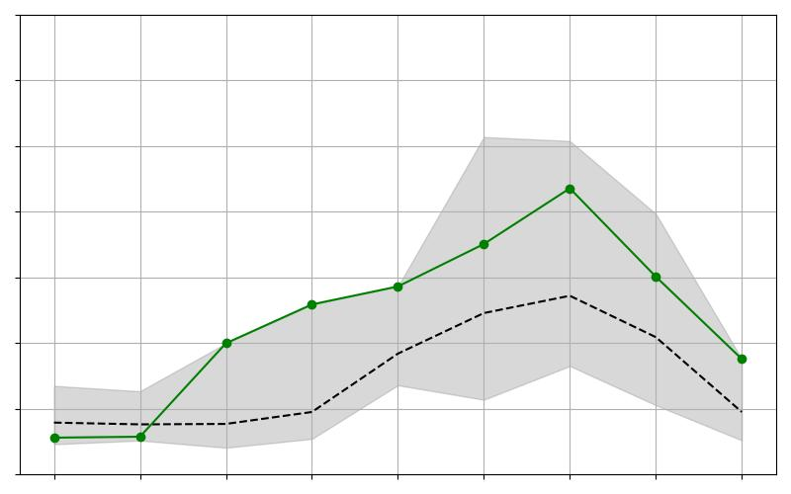
Phenology
GA-70
TX-12
0.8
0.8
0.7
0.7
0.6
0.6
0.5
0.5
EVI
EVI
0.4
0.4
0.3
0.3
0.2
0.2
0.1
0.1
Mar
Apr
May
Jun
Jul
Aug
Sep
Oct
Nov
Mar
Apr
May
Jun
Jul
Aug
Sep
Oct
Nov
Average
2022
Range
Texas & Georgia Agriculture
Notes:
Speaker Notes:
This slide shows a comparison of the 2022 EVI time series, as a representative year, to the monthly average and range for the GA-70 and TX-12 NASS districts. The 2022 EVI time series is notably higher than the average for both districts, aligning with the fact that 2022 recorded the highest yield for GA-70 and the second highest yield for TX-12 within the study timeframe.
However, considering the extreme drought conditions Texas experienced in 2022, our partners hypothesized that this anomaly might be due to irrigation. Observations from EVI images and Google Earth revealed that a significant portion of the Texas districts consisted of pivot irrigation farms. This represents one of the limitations of our study, as we did not account for rainfed and irrigated farms.

Slide 15
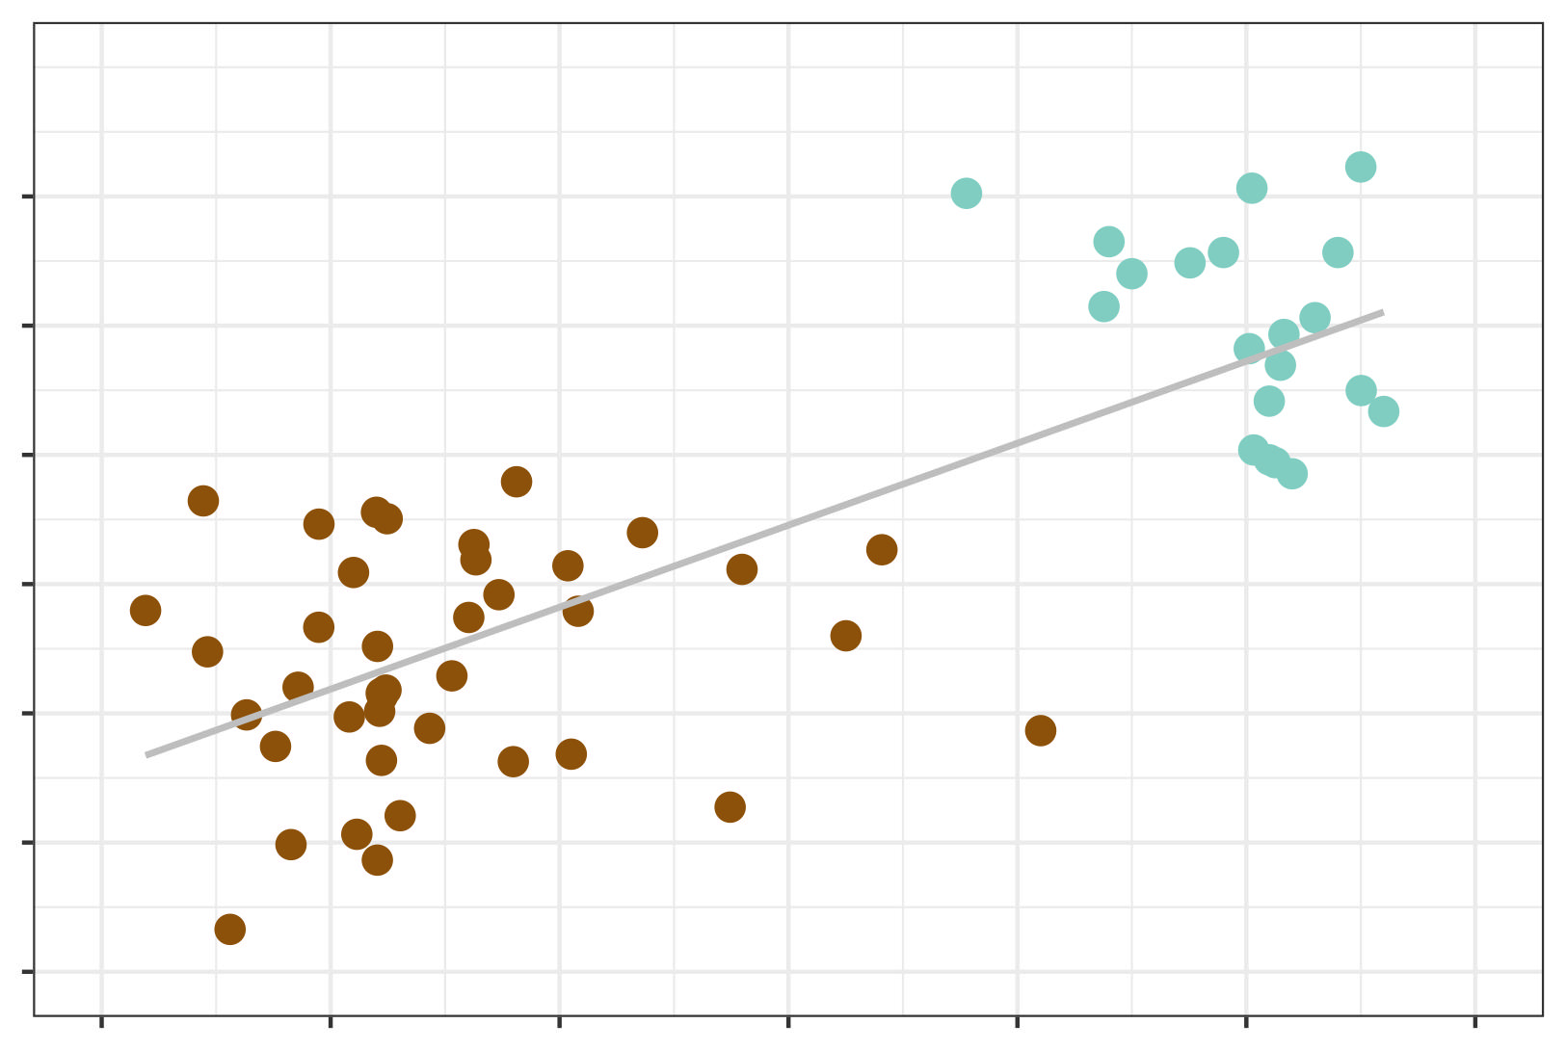
Separating the Analysis
Georgia
Cluster
82
81
Average
Length
Uniformity
80
Texas
Cluster
79
Average
July EVI
0.15
0.45
0.75
Texas & Georgia Agriculture
Notes:
Speaker Notes:
In attempting to see which environmental factors may be driving differences in cotton quality, we decided that it was important to divide our analysis according to states. This graph illustrates why this was necessary- looking at the trend line of all of the data points together, there appears to be a fairly strong positive correlation between average EVI readings in July and the eventual average length uniformity readings from the end-of-season harvests; in fact, the correlation coefficient here is r = 0.77. However, this trend is driven by the fundamental differences between the two states. Within each cluster- GA districts are all in the upper right, and Texas districts are all in the lower left- we see that there is, at best, a weak association between July EVI and length uniformity.

Slide 16
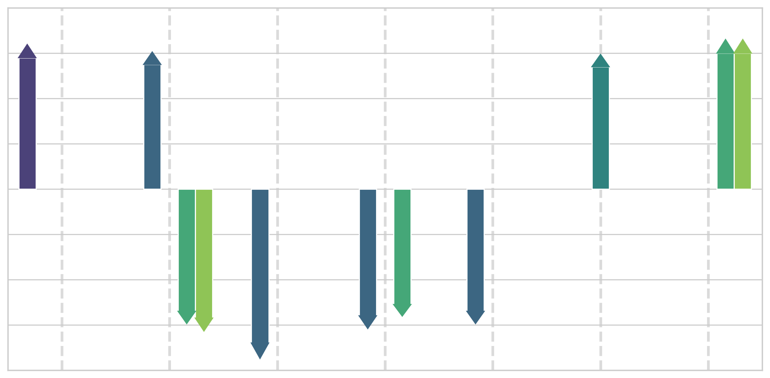
RZSM
GDD
EVI
Precip
Key Variables in Texas
GDD
0.8
0.6
0.4
0.2
Correlation
Coefficient
0.0
-0.2
RZSM
RZSM
RZSM
Precip
RZSM
-0.4
Precip
July
August
-0.6
September
October
November
-0.8
Fiber Length
Reflectance
Yellowness
Fiber Strength
Length Uniformity
Micronaire
Trash Surface Area
Texas & Georgia Agriculture
Notes:
Speaker Notes:
The primary piece of our analysis to find drivers of cotton quality was a multiple regression analysis. This figure indicates which predictors were found to be consistently associated with which quality measurements at different months of the growing season in Texas. During the crop's early stages, not many variables appeared as meaningful predictors in our regression models, as evidenced by the absence of any key variables in the months of May and June. In July, growing degree days showed a strong positive correlation with eventual average fiber length. In August, which roughly corresponds to the flowering stage for much of the crop in western Texas, precipitation was strongly associated with crops that were lower in yellowness, and root zone soil moisture was negatively associated with both fiber strength and uniformity. EVI readings in August showed a positive association with the brightness of the crop at the time of processing. Moving into the back half of the growing season, heat in September generally led to thicker fibers, as show by the positive correlation between September GDD and micronaire. At the end of the season, both high precipitation and high root zone soil moisture in a district were associated with crops that had more surface area trash and were darker in color. While high trash matter is an undesirable outcome, darker color in and of itself is not necessarily a negative outcome, as the color grade of a bale depends on both its reflectance and its yellowness measurement.

Slide 17
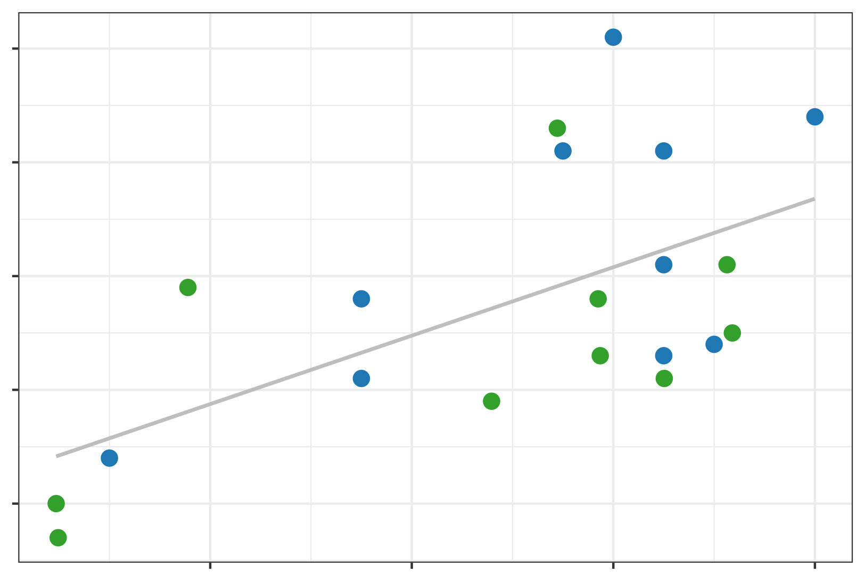
Key Variables in Georgia
1.16
Correlation coefficient
value of 0.61
Average
Fiber
Length (in.)
1.14
Blue = GA-70
Green = GA-80
1.12
0.60
0.68
0.76
Average August EVI
Texas & Georgia Agriculture
Notes:
Speaker Notes:
In Georgia, we had difficulty establishing convincing associations between our predictors and the cotton variables due to low statistical power in our study. However, we were still able to perform correlation analyses and noted that the Enhanced Vegetation Index demonstrated a moderate correlation with three important cotton measurements throughout the summer months. As early as July, EVI was demonstrating a positive correlation with both fiber strength and fiber length, and this persisted throughout August and September. July and August correspond to the flowering and boll development stages of the cotton crop. Cotton fiber length is completely determined during the first three weeks after the flower has been fertilized and the closed boll is developing, so the pattern shown in the scatterplot here makes sense- when we pick up on higher-than-normal EVI readings from remotely sensed cotton fields during the flowering and boll development stages (indicating vigorous crops) we can anticipate that the fiber lengths at harvest time will generally be higher-than-normal as well.

Slide 18
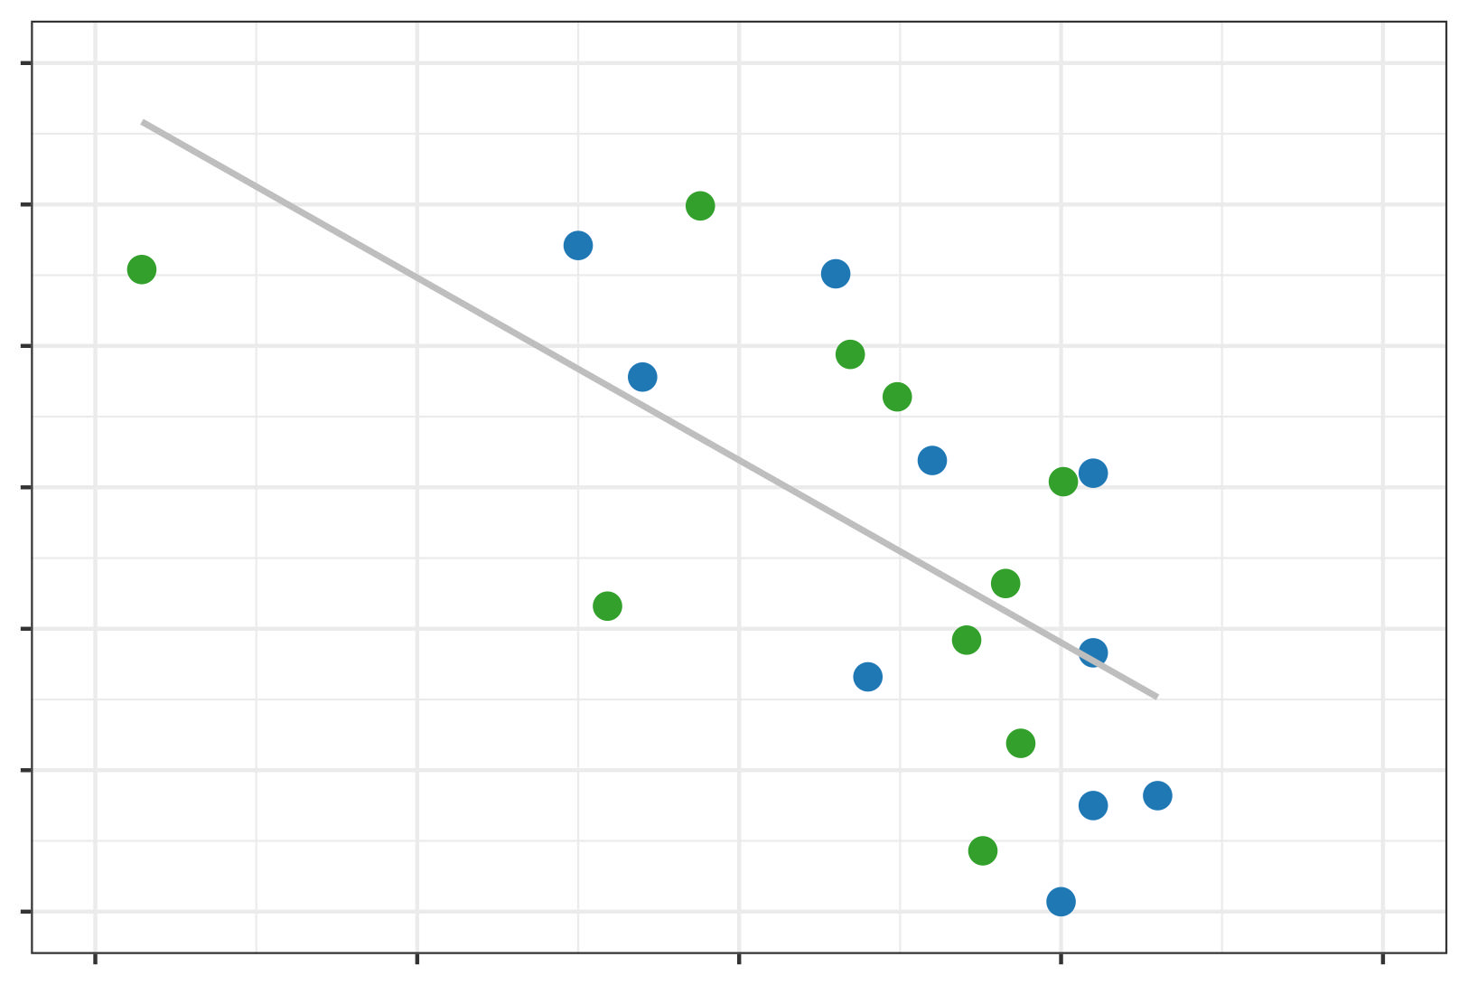
Key Variables in Georgia
4.8
Correlation coefficient
value of - 0.64
Average
Micronaire
4.5
Blue = GA-70
Green = GA-80
4.2
0.4
0.6
0.8
Average September EVI
Texas & Georgia Agriculture
Notes:
Speaker Notes:
Over those same months of July through September in Georgia, EVI demonstrated a persistent negative correlation with the average micronaire of the eventual crop. Shown here is a scatterplot of the average September EVI versus average micronaire for the ten years of the study. On a previous slide, we saw that average September EVI readings in cotton fields of this part of Georgia were about 0.65; following that value up to the trendline, this was associated with crops whose average micronaire readings were about 4.45, which is at the upper end of the range of desirable values for micronaire. A plausible interpretation of the negative trend seen here is that crops with lower-than-average EVI readings in September (on the left side of the graph) are an indication that bolls have been shed from plants and/or have opened prematurely due to stress. Both of these possibilities lead to an over-concentration of carbohydrates in the cotton fibers that remain, causing cells walls to thicken and micronaire to increase. The main take-away from these last two slides is that indices derived from satellite observations taken in mid-summer can provide an indication of the average quality readings of the crops that will be harvested in autumn. One further interesting finding in Georgia was that similar to Texas, there was a strong negative correlation between the late-season precipitation and root zone soil moisture readings and the brightness of the crop.

Slide 19
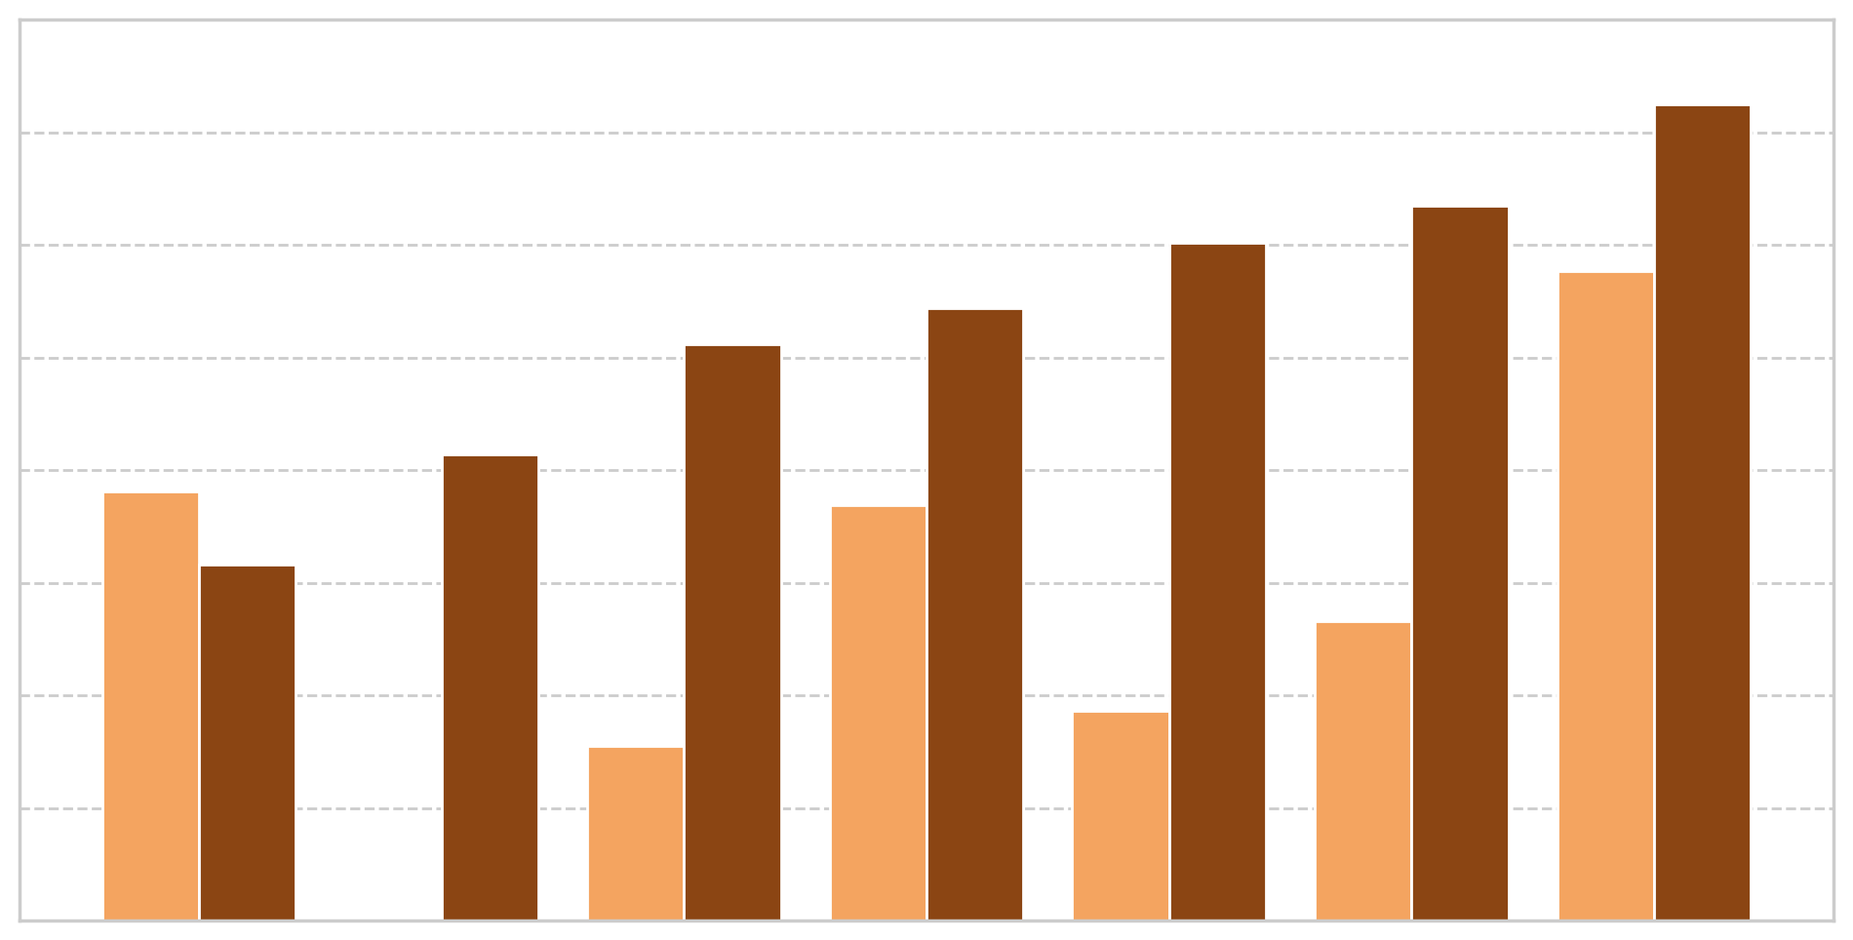
Predictions with Remote Sensing: Texas
80
Model without RS
Model with RS
70
60
Adjusted
R-squared
50
40
30
20
10
Color Yellowness
Length Uniformity
Fiber Length
Fiber Strength
Color Reflectance
Trash Surface Area
Micronaire
Texas & Georgia Agriculture
Notes:
Speaker Notes:
We compared the predictive power of our regression models that incorporated remote sensing observations to those models that used only modeled data from weather stations. The smaller models used only Growing Degree Days and maximum wind speeds, while the larger models used this data, as well as the Enhanced Vegetation Index, Root Zone Soil Moisture estimates, and IMERG precipitation estimates. Since adding more variables to a linear regression model can only increase the amount of variation in the response variable that the model is able to explain, we used adjusted R squared as the metric to compare the two different types of models. Adjusted R squared penalizes models which have irrelevant or highly collinear variables as predictors, and is generally regarded as a reliable tool for evaluating the performance of models with differing numbers of predictors. The side-by-side bar chart shows that for each of the primary quality metrics we examined (with the exception of yellowness), the model that used predictors based on satellite data outperformed the simpler models, and by a large margin in some cases. This indicates the promise of incorporating remote sensing observations into predictions for the quality of cotton harvests, even at the coarse spatial scale of multi-county agricultural districts.

Slide 20



Conclusions
Feasibility: Earth observations and derivative products add useful inputs for predicting cotton quality attributes with in-season measurements
Identification: Distinct variables at key times in the cotton growth cycle (generally mid- to late-season) are associated with certain quality measurements in Texas and Georgia
Validation: Regression models can be used to estimate quality values at the district level starting in July/August but should be used with care given the small sample size in the study
Texas & Georgia Agriculture
Notes:
Speaker Notes:
In conclusion, our feasibility study demonstrated the value of incorporating satellite data into predictions of cotton quality measures. The tentative findings from this study were that wet autumns were associated with lower brightness in cotton crops across both states, summer EVI readings had moderate-to-strong associations with some quality variables in Georgia, and August moisture was an important driver of multiple quality variables in Texas. More years of data collection and analysis could expand upon these connections.
Image Credit: Microsoft PowerPoint Icons

Slide 21




Uncertainties and Limitations
Time-consuming data acquisition: Different sources and different formats
Incomplete data: No cotton quality data was available for some counties within study area
Data assumptions: Planting dates, harvest dates, and harvest field locations not provided
Survival bias: In some years, a high proportion of planted acres were abandoned
Texas & Georgia Agriculture
Notes:
Speaker Notes:
We'll close with some words of caution about reading too much into our results and share ideas about how future research in this domain could ideally improve upon some of the constraints we faced, first of which was the simple time constraint imposed by the length of the DEVELOP term.
We were not able to obtain complete data in counties and districts where there were a small number of cotton gins due to privacy issues. This required dropping one of the NASS districts that was in our original scope (GA-90) from the study.
Another major limitation to our study had to do with assumptions regarding the cotton quality data- we were provided the date when, and the location where, the quality measurements were taken as each cotton bale was processed, but not when the crop was planted nor harvested, nor the exact location that it was grown, which actually could have been in a different district than where the processing occurred.
A final note of caution regarding this study concerns survival bias. We found out partway through our project that abandonment rates were actually quite high for some of the drought years in Texas, reaching a peak of 84% abandonment in 2022. However, we only received quality readings from cotton fields that were harvested. So fields that were abandoned mid-season due to unpromising conditions were not included in the analysis, and these fields can safely be assumed to be of lower quality, which probably led to some biased associations in our models.
Image Credit: Microsoft PowerPoint Icons

Slide 22
PARTNERS
Michael Cosh, USDA, ARS
Chris Delhom, USDA, ARS
Barbara Meredith, USDA, AMS
Vikki Martin, Cotton Inc.
Ed Barnes, Cotton Inc.
NASA DEVELOP
Sean McCartney, Science Advisor at GSFC
Thomas Holmes, Science Advisor at GSFC
Manh-Hung Le, Science Advisor at GSFC
Yoseline Angel Lopez, Science Advisor at GSFC
Joe Spruce, Science Advisor at GSFC
Spencer Harman, Center Lead at GSFC
Marisa Smedsrud, Geoinformatics Fellow at GSFC
Dr. Kent Ross, DEVELOP Program Manager
Notes:
Speaker Notes:
We wish to express our sincere thanks to a number of people who provided valuable guidance and insightful ideas throughout this experience.

Slide 23
Backup Slides
Texas & Georgia Agriculture
Notes:
Speaker Notes:
We'll close with some words of caution about reading too much into our results and share ideas about how future research in this domain could ideally improve upon some of the constraints we faced, first of which was the simple time constraint imposed by the length of the DEVELOP term.
We were not able to obtain complete data in counties and districts where there were a small number of cotton gins due to privacy issues. This required dropping one of the NASS districts that was in our original scope (GA-90) from the study.
Another major limitation to our study had to do with assumptions regarding the cotton quality data- we were provided the date when, and the location where, the quality measurements were taken as each cotton bale was processed, but not when the crop was planted nor harvested, nor the exact location that it was grown, which actually could have been in a different district than where the processing occurred.
A final note of caution regarding this study concerns survival bias. We found out partway through our project that abandonment rates were actually quite high for some of the drought years in Texas, reaching a peak of 84% abandonment in 2022. However, we only received quality readings from cotton fields that were harvested. So fields that were abandoned mid-season due to unpromising conditions were not included in the analysis, and these fields can safely be assumed to be of lower quality, which probably led to some biased associations in our models.
Image Credit: Microsoft PowerPoint Icons

Slide 24
Key Variables in Texas
Predictor
Quality Indicator (Correlation Coefficient)
GDD
Length (.58)
EVI
Reflectance (.55)
June | July | August
RZSM
Strength
(-.56)
Uniformity
(-.54)
No associated predictors
Precipitation
Yellowness
(-.68)
Texas & Georgia Agriculture
Notes:
Speaker Notes:
The primary piece of our analysis to find drivers of cotton quality was a multiple regression analysis. This slide and the following one show an annual map of which predictors were found to be consistently associated with certain quality measures at various times of the growing season in Texas. During the crop's early stages, not many variables appeared as meaningful predictors in our regression models. Only growing degree days in July showed a strong positive correlation with eventual average fiber length. In August, which roughly corresponds to the flowering and boll development stage for much of the crop in western Texas, the precipitation was strongly associated with crops were lower in yellowness, while root zone soil moisture was negatively associated with both fiber strength and uniformity. EVI readings in August showed a positive association with the brightness of the crop at the time of processing.

Slide 25
Key Variables in Texas
GDD
Micronaire (.54)
Precipitation
Trash
(.60)
RZSM
Trash
(.60)
September | October | November
Precipitation
Reflectance (-.54)
RZSM
Strength (-.51)
RZSM
Reflectance (-.57)
Texas & Georgia Agriculture
Notes:
Speaker Notes:
Moving into the back half of the growing season, heat in September (as measured by GDD) generally led to thicker fibers. At the end of the season, high root zone soil moisture (estimated at a depth of 5 centimeters to 1 meter) in a district was associated with crops that had more surface area trash, lower fiber strength, and were darker in color. When precipitation was high at the end of the growing season, there was a similar correlation with crops that were high in trash matter and darker in color.

